Slide 1
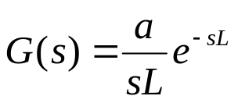









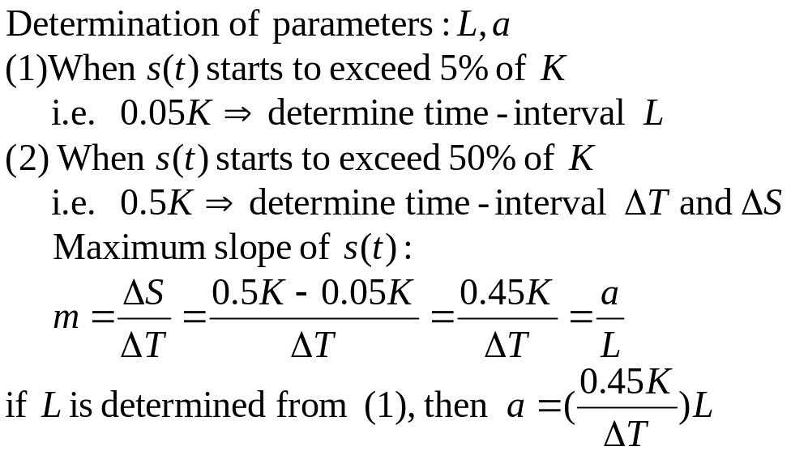
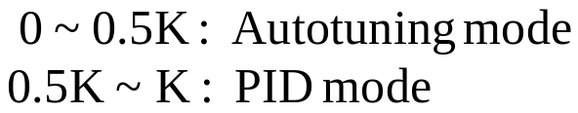
♦ PID Controller Auto-tuning Algorithm:
Two parameters model:
An integrator with dead time L

Slide 2
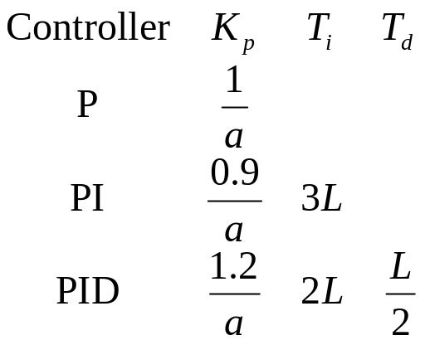
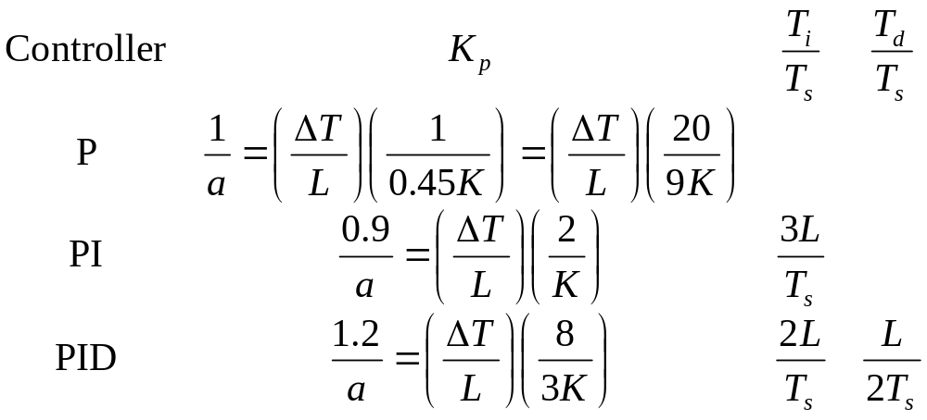
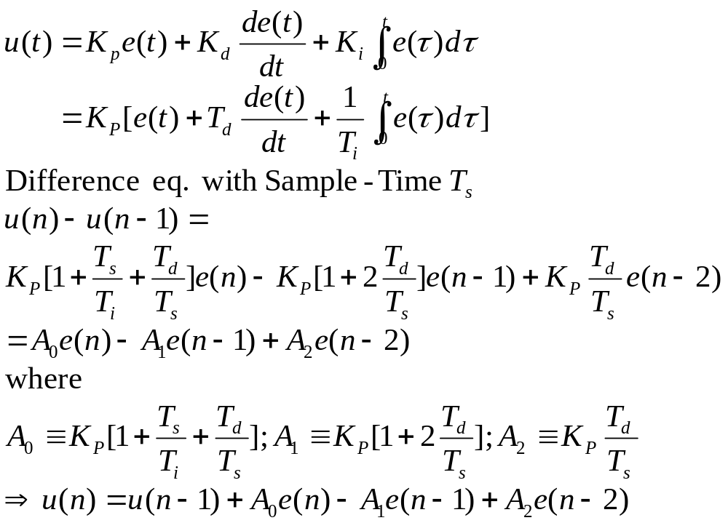
By Ziegler-Nichols step response method:

Slide 3
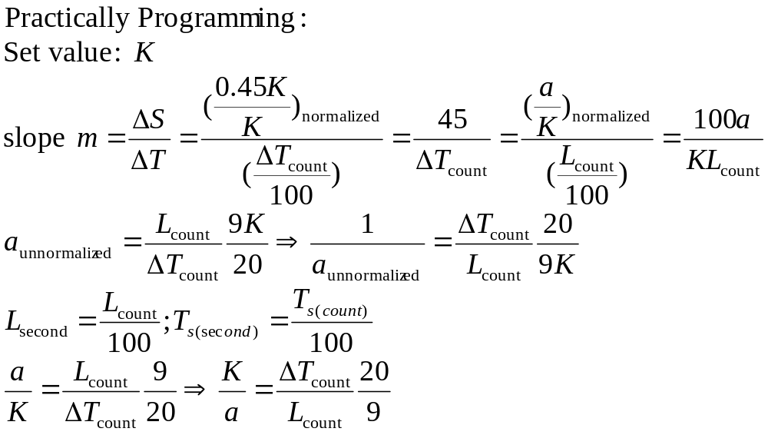
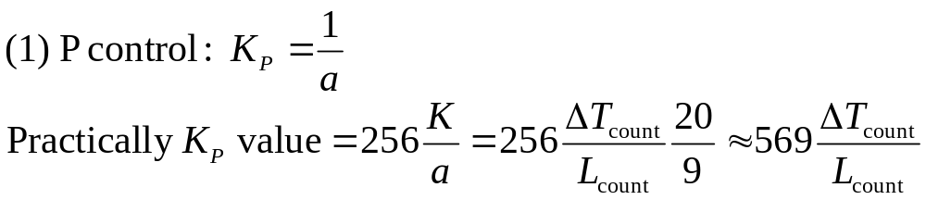
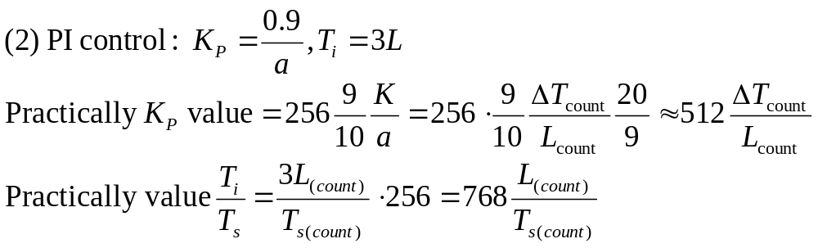
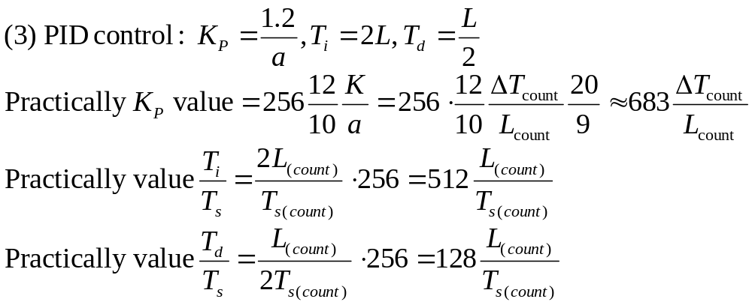

Slide 4
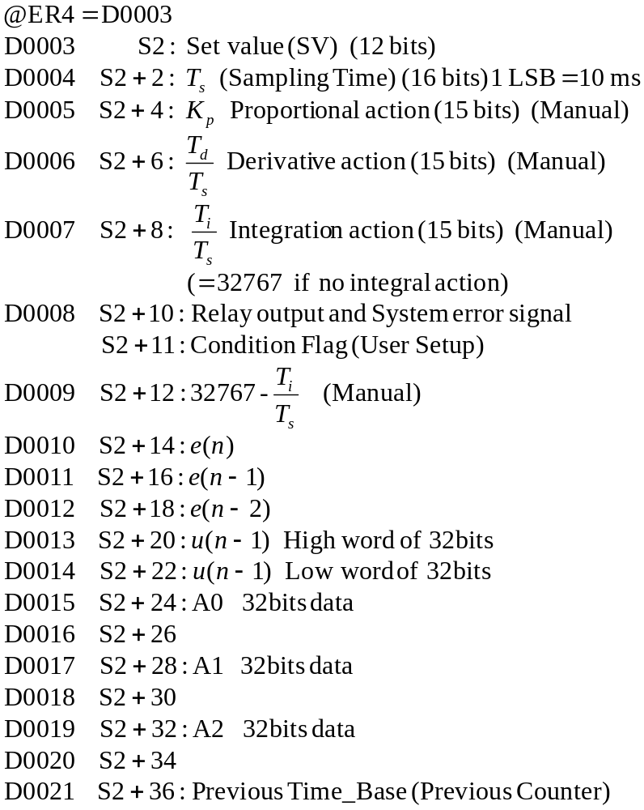
指令：PIDA D S1 S2
D:輸出通道位址 (Actuator)-----@ER2
S1:輸入通道位址(Sensor)-----@ER3
S2:Setting Control Parameters----@ER4

Slide 5
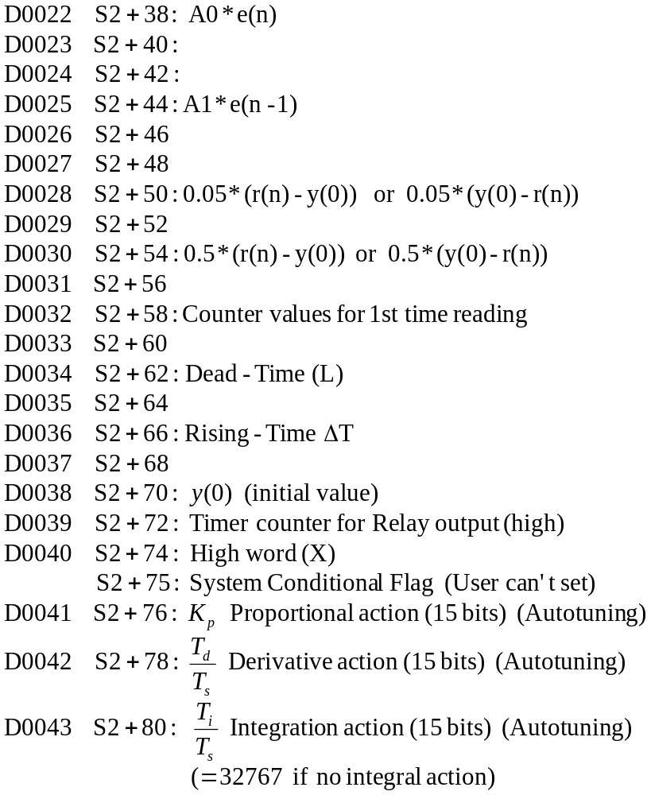

Slide 6
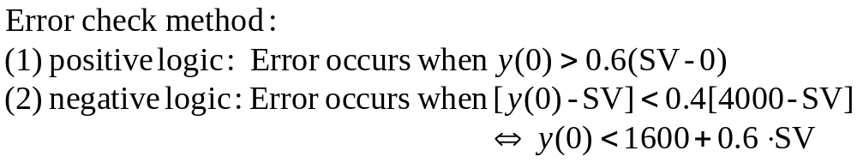
Conditional Flag (user setup)
4 bits
4 bits
4 bits
4 bits
15 14 13 12
11 10 9 8
7 6 5 4
3 2 1 0
(S2+10)
@(D’11:24,ER4)
(S2+11)
@(D’10:24,ER4)
(S2+11)
Bit 1
Bit 0
Bit 2
P
0
0
0
Auto-tuning mode
PI
0
1
1
PID mode
PID
1
0
Bit 3
Bit 4
0
Analog Output
0
Positive Logic
1
Relay Output
1
Negative Logic
(S2+10)
Bit 8
0
Relay output low
1
Relay output high
Bit 9
0
Auto tuning working properly
1
Error Signal (Auto tuning fails)

Slide 7
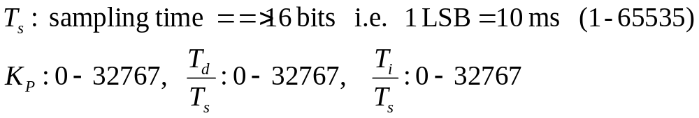
Conditional Flag (system use)
4 bits
4 bits
4 bits
4 bits
15 14 13 12
11 10 9 8
7 6 5 4
3 2 1 0
(S2+74)
@(D’36:24,ER4)
(S2+75)
@(D’37:24,ER4)
(S2+75)
Bit 0
1st time to run Auto-tuning mode
(To compute 0.5(r(n)-y(0)) & 0.05(r(n)-y(0)))
0
1
X
Bit 1
0
(y(n)-y(0))<0.05(r(n)-y(0))
1
(y(n)-y(0))>0.05(r(n)-y(0))
Bit 2
0
1st time to read initial counter values
1
X
Bit 3
0
1st time to run PID,initialize u(n-1)
1
X
Bit 4
0
Auto tuning mode is not ready
1
Auto tuning mode is ready

